Slide 1
Why study
Principles of Management

Slide 2
Management
Management is the process of designing and maintaining an environment in which individuals work together in groups to efficiently and effectively accomplish selected aims.

Slide 3
Productivity
Productivity = Outputs/Inputs*
Increasing outputs with same inputs
Decreasing inputs with same outputs
Increasing outputs and decreasing inputs
*Within a time period, keeping same quality

Slide 4
Effectiveness
Achievement of objectives
Efficiency
Achievement of the ends with the least amount of resources

Slide 5
Manager
A manager is an organizational member who coordinates and oversees the work “of other people” so organizational goals can be accomplished

Slide 6
Organization
A group of people working together to create a surplus.
In business organizations, surplus is profit
In NPOs surplus is satisfaction of needs
In Universities/college, surplus is generation and dissemination of knowledge

Slide 7
Levels of Management
First Line or Frontline Managers
Supervisors, Shift managers, office managers
Middle Managers
Regional Manager, Project manager, store manager, Floor manager, division manager
Top Managers
Executive Vice President, President, Managing Director, CEO, COO

Slide 8
Management Functions (POSDCORB*)
Planning
Organizing
Staffing
Directing
Coordinating
Reporting
Budgeting
*Luther Gulick

Slide 9
Management Functions*
Planning
Organizing
Staffing
Leading
Controlling
*Koontz and O’Donnell

Slide 10
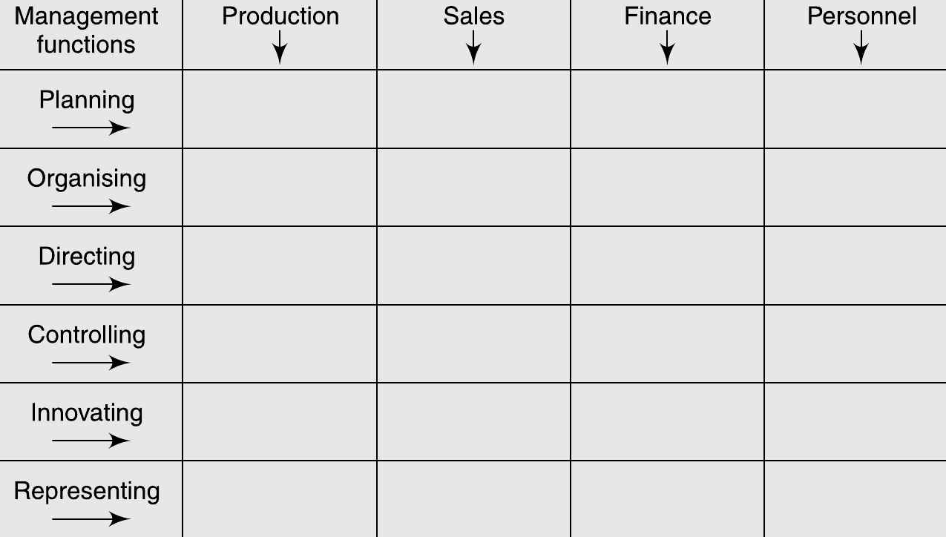
Business Functions and Management Functions

Slide 11
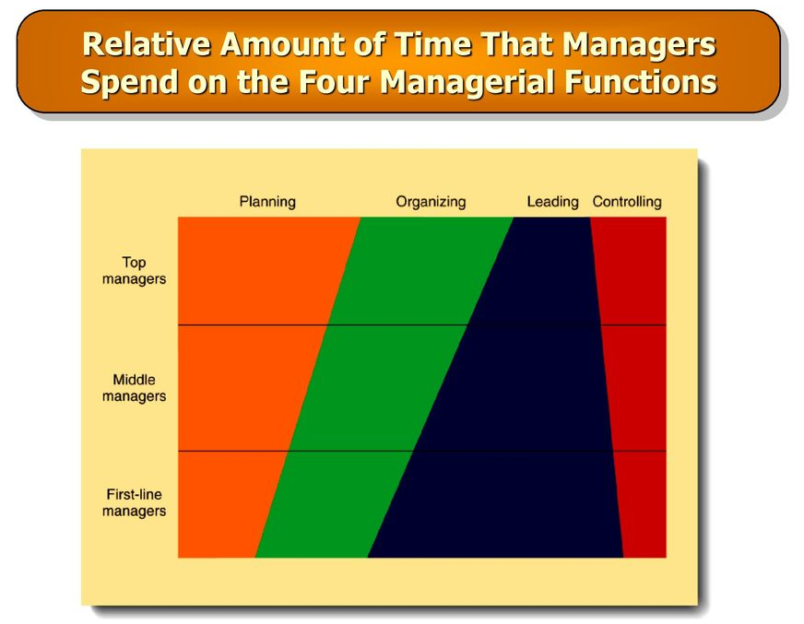

Slide 12
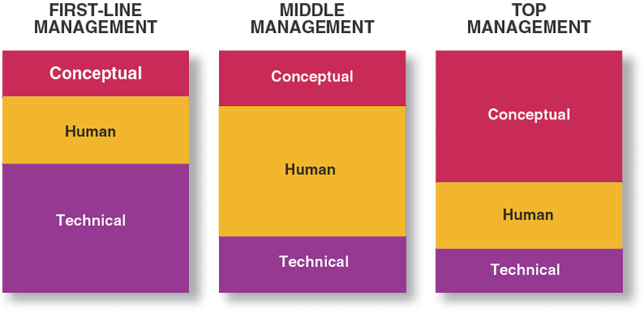
Skills and Management Levels

Slide 13
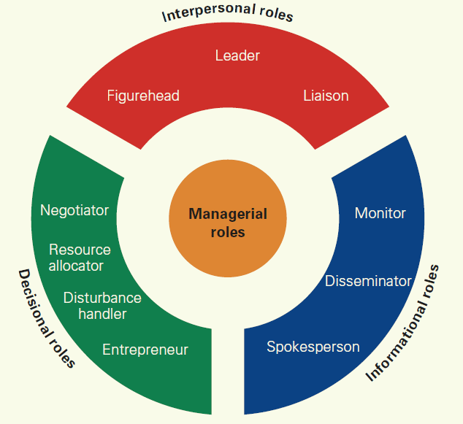
Mintzberg’s 10 Management Roles

Slide 14
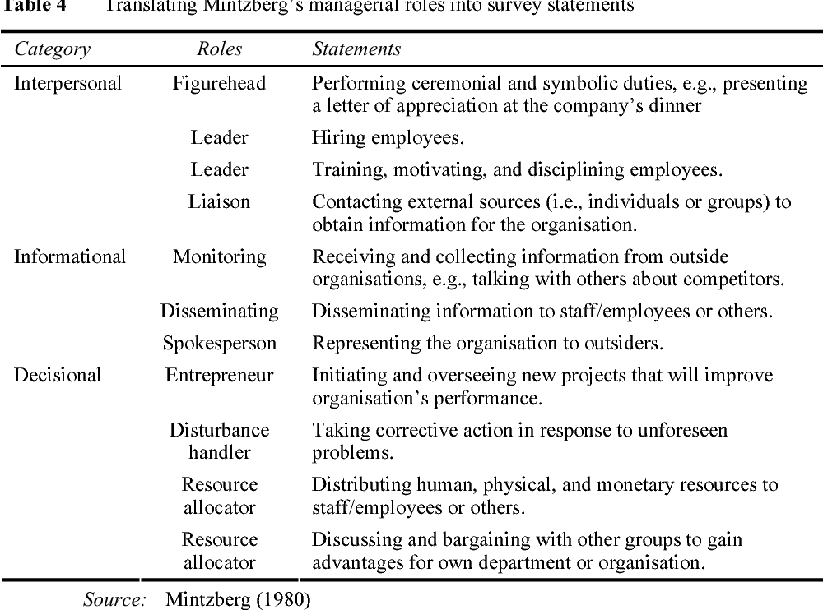
Mintzberg’s 10 Management Roles

Slide 15
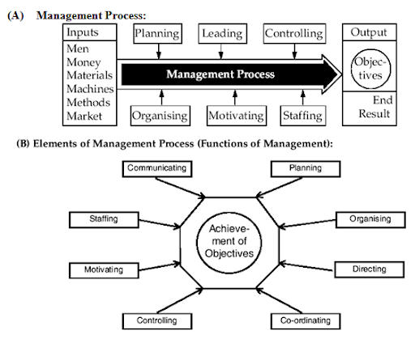
Systems Approach to Management

Slide 16
Is Management
A Science
or
An Art ?

Slide 17
Management as a science
When is a discipline scientific?
Systematic and Empirical methods of enquiry
Information can be ordered and analyzed
Results are cumulative and communicable

Slide 18
Management as a science
Systemized Body of Knowledge
Principles Based on Experimentation
Verifiable Principles
Universal Application

Slide 19
Management as an art
While science is ‘why’ of a phenomenon, art is ‘how’ of it
Management is the art of getting things done through others
A manager depends on his managerial skills and qualities to apply principles and theories to his specific problem
A manager just like a musician or an artist does not copy the skills of others

Slide 20
Management as an art
Practical Knowledge
Personalized Application of Knowledge
Improvement through Continuous practice
Situational Application
Emphasis on Creativity

Slide 21
Comparison between Art and Science as used in Management
Art | Science
Advances by practice | Advances by knowledge
Feels | Proves
Guesses | Predicts
Decribes | Defines
Opines | Measures
Expresses | Impresses

Slide 22
Management as a profession
Characteristics of a profession*
Existence of an organized and systematic knowledge
Formalized methods of acquiring training and experience
Existence of an association with professionalization as its goal
Existence of ethical code to regulate behavior of the profession
Charging of fees based on service but priority of service over the desire for monetary reward
*McFarland

Slide 23
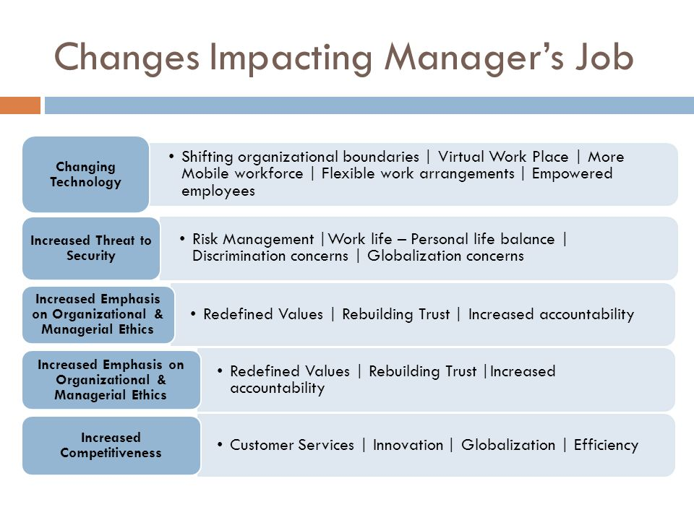

Slide 24
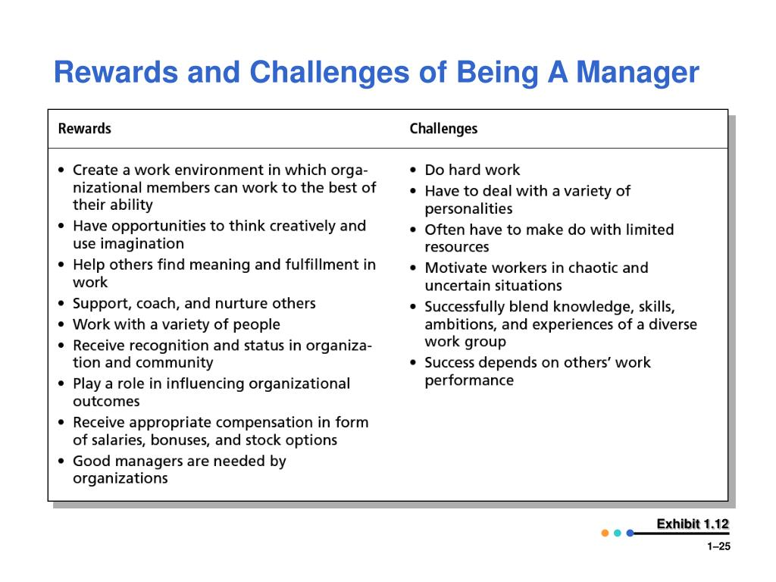
Rewards and Challenges of Being a Manager

